Slide 1
West Cataract Creek Dam
Damsel in Distress Engineering
Dustin Hailpern, Kallam Kruse, Ethan Shadley, and Jaclyn Zibrat

Slide 2
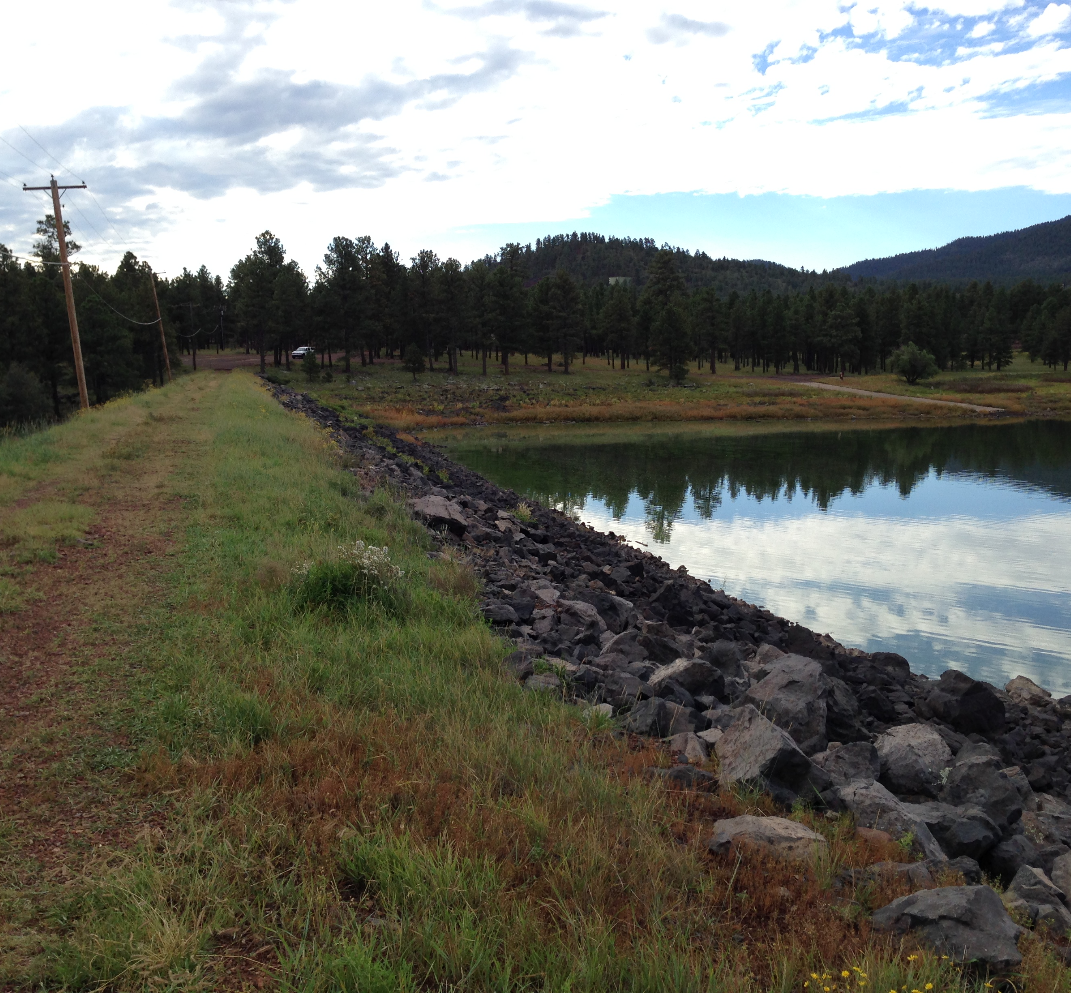
Overview
Project Description
Background Information
Accomplished Work
Failure Modes
Recommendations
Image taken by Dustin Hailpern

Slide 3
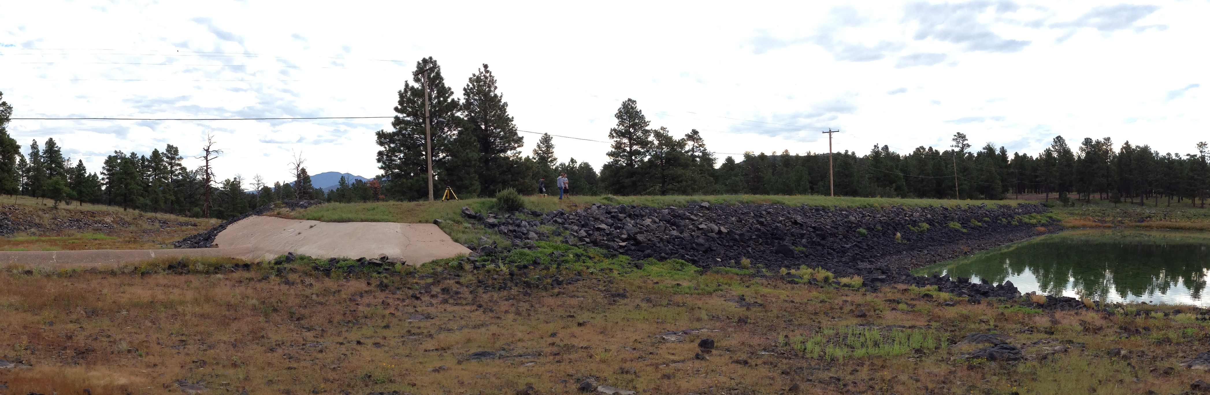
Project Description
West Cataract Creek Dam
  Research probable failure modes
  Analyze safety of dam
  Determine effects of a failure on the City of Williams
Image taken by Dustin Hailpern
Notes:
Our client, Mark Lamer, wanted us to research West Cataract Creek Dam to determine the probable failure modes and how a dam failure would affect the City of Williams.

Slide 4
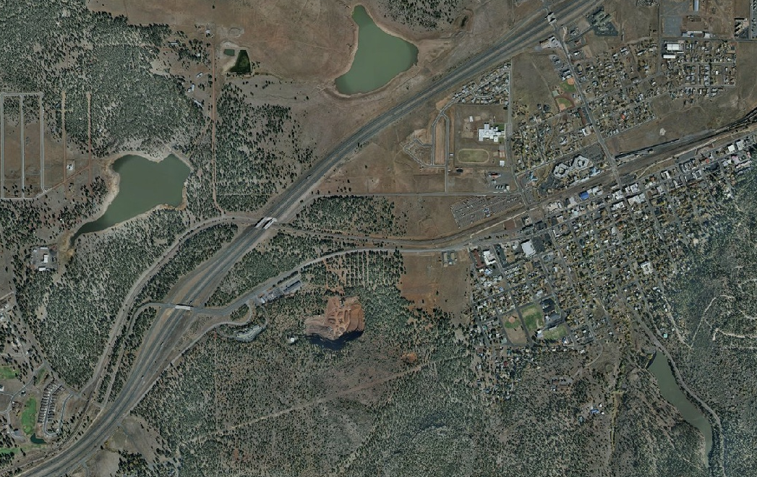
West Cataract Creek Dam
I-40
Williams, AZ
Image taken from Mapquest

Slide 5
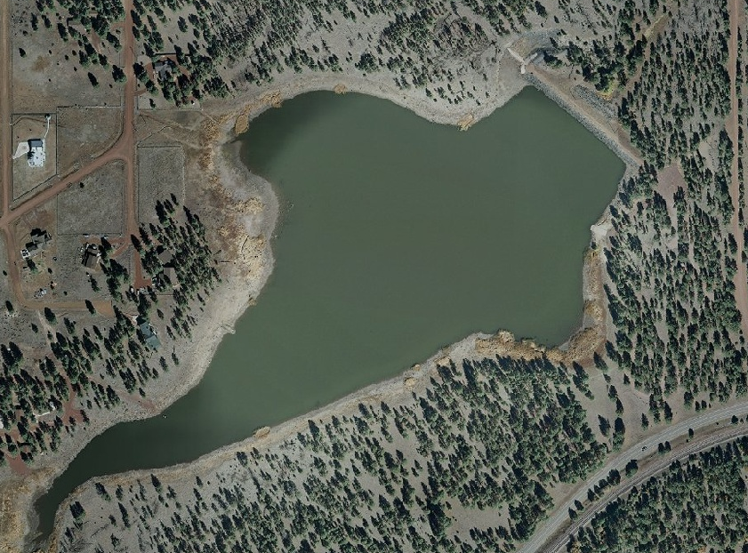
West Cataract Creek Dam
Image taken from Mapquest

Slide 6
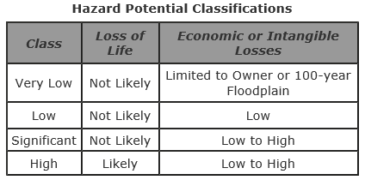
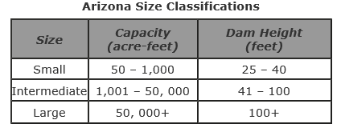
Background Information
Creates Cataract Lake
  411 acre-feet (135 mil gallons)
Earthen dam, concrete spillway
Built in 1947, altered in 1968
ADWR
  Significant safety concern
  “Small” dam
6.03 square mile watershed
Images from ADWR website

Slide 7
Accomplished Work
Researched historical dam failures
Site visit
  Surveyed geometry
  Compared conditions to previous reports
Document Procurement
  Drawings, previous analysis
Analysis
  Watershed delineation
  Overtopping
  Spillway Failure
  Slope Stability
  Internal Erosion

Slide 8
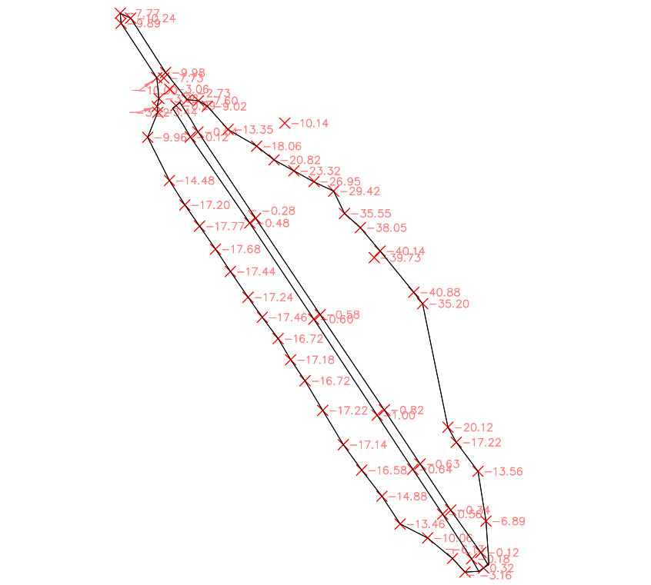
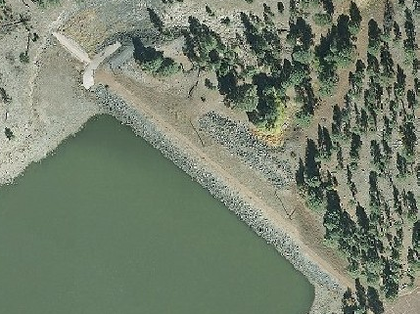
Surveyed Points
Images taken from Mapquest and AutoCAD

Slide 9
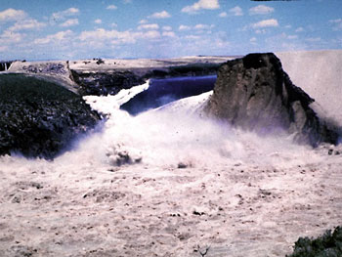
Failure Modes
Four Most Relevant
  Slope Stability
  Internal Erosion
  Overtopping
  Spillway Failure
Sunny vs Rainy Day Failure
Dam Breach
Image taken from the U.S. Department of Interior, Bureau of Reclamation
Notes:
Why we chose these → most probable

Slide 10
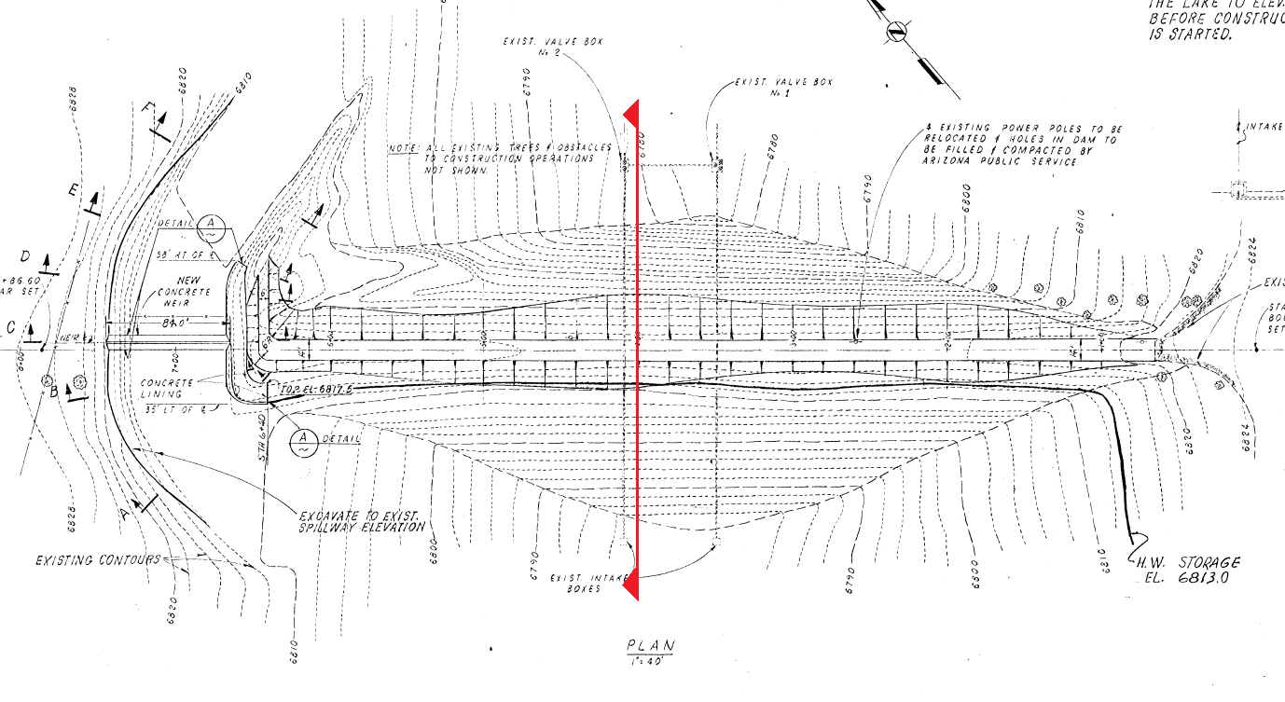
Slope Stability
Rocscience Slide Software
  Conservatively assumed “unconsolidated undrained” soil
  Modified Bishop and Janbu methods
Image taken from John Carollo Engineers, provided by ADWR

Slide 11
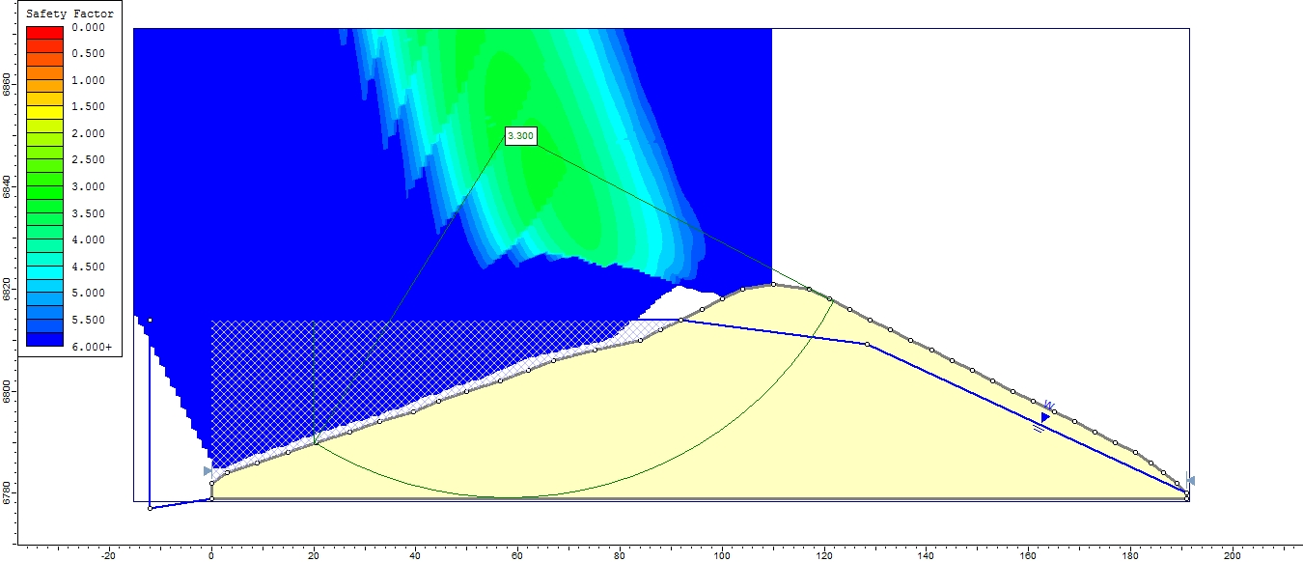
Slope Stability
Results and Findings
  Lowest Factor of Safety: 3.30
Image taken from Rocscience Slide Software

Slide 12
Internal Erosion
Flow net analysis
  Seepage velocities sufficient to carry particles
Analysis method not used
  No particles apparent in seepage
  Seepage not significant

Slide 13
Overtopping Analysis
Bentley PondPack
  Allowed creation of model that accurately reflects real conditions
  More reliable outflow values
  Water surface elevation values
  Ran separate computations for a post-burned scenario with each storm event

Slide 14
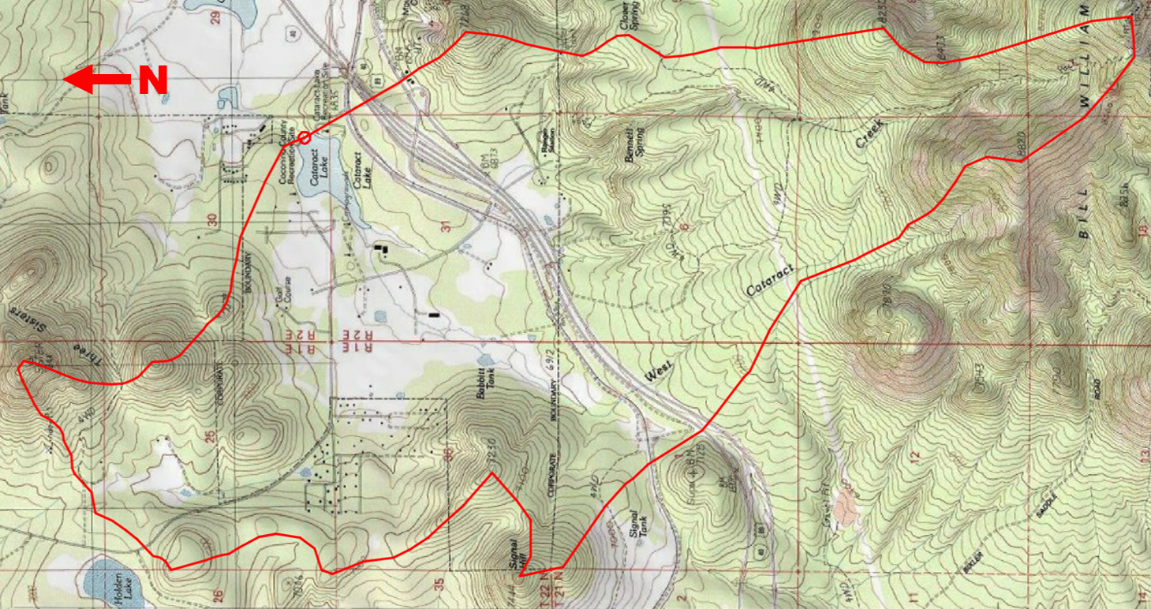
Watershed Delineation
6.02 square miles
Image taken from AutoCAD Civil 3D Software

Slide 15
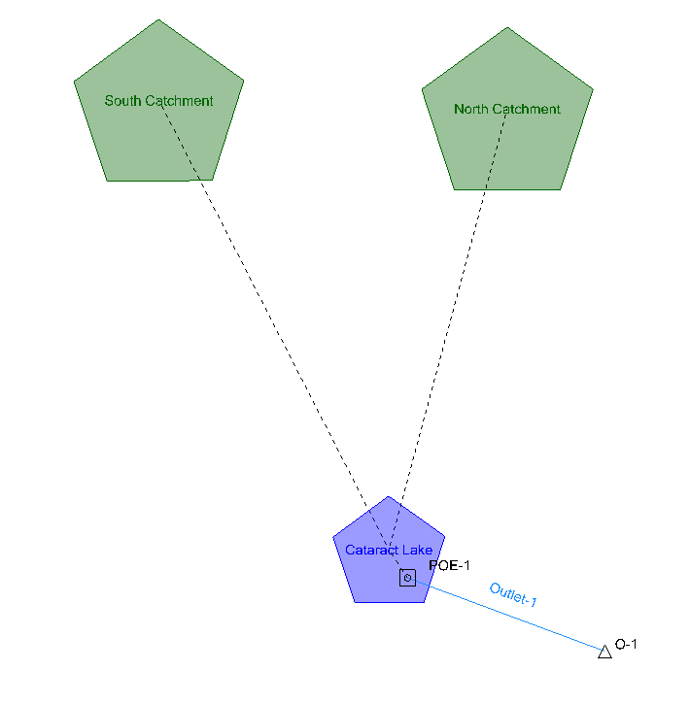
PondPack Model
Split watershed into two separate areas
  SCS Curve Method used
Reservoir
Outlet
Outfall
Return Events
  1 year-1000 year storm
Image from PondPack Software

Slide 16
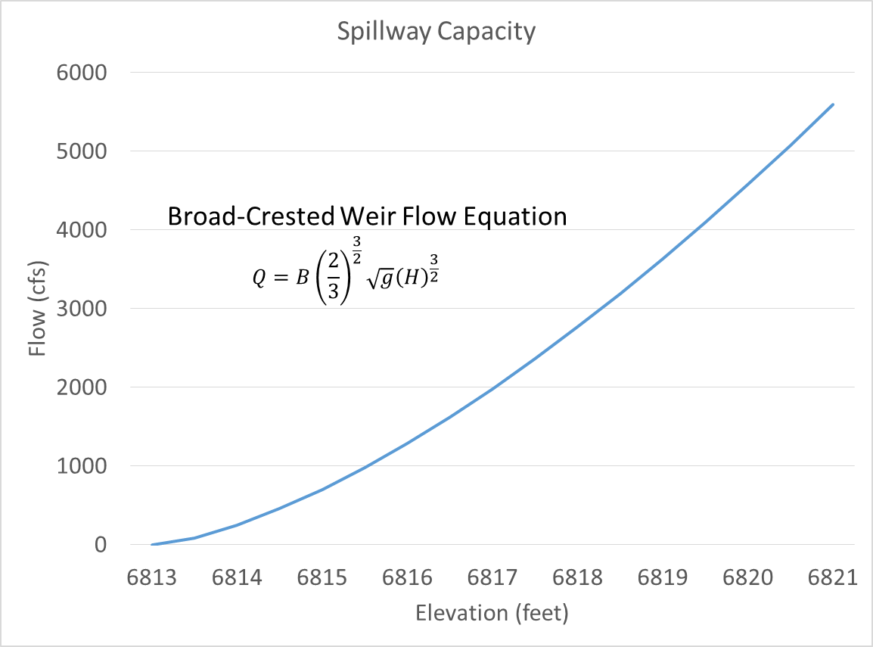
Spillway Capacity Curve
Elevation (ft) | Flow (cfs)
6813 | 0
6813.5 | 87.39
6814 | 247.17
6814.5 | 454.07
6815 | 699.09
6815.5 | 977.01
6816 | 1284.32
6816.5 | 1618.42
6817 | 1977.33
6817.5 | 2359.44
6818 | 2763.41
6818.5 | 3188.12
6819 | 3632.60
6819.5 | 4096.00
6820 | 4577.59
6820.5 | 5076.71
6821 | 5592.75
Image from Microsoft Excel

Slide 17
Pre-Burned Model
Maximum Water Surface Elevation – 6821 ft.
Maximum Spillway Capacity – 5592.75 cfs
SCS Curve Number – 67.00
Pre-Burn Conditions
Storm Event | Water Surface Elevation (ft.) | Reservoir Inflow (cfs) | Spillway Outflow (cfs) | Pass or Fail
50 Year Event | 6813.91 | 1446.20 | 430.56 | Pass
100 Year Event | 6815.14 | 2045.69 | 1076.34 | Pass
200 Year Event | 6816.63 | 2927.75 | 2080.57 | Pass
500 Year Event | 6818.52 | 4354.60 | 3650.29 | Pass
1000 Year Event | 6820.01 | 5670.51 | 5090.32 | Pass
Table from Microsoft Excel, SCS Curve Number from WILDCAT 4 Flow Model (Hawkins & Greenberg 1990)

Slide 18
Post-Burn Model
Maximum Water Surface Elevation – 6821 ft.
Maximum Spillway Capacity – 5592.75 cfs
SCS Curve Number – 90.00
Post-Burn Conditions
Storm Event | Water Surface Elevation (ft.) | Reservoir Inflow (cfs) | Spillway Outflow (cfs) | Pass or Fail
50 Year Event | 6815.15 | 5353.13 | 1079.74 | Pass
100 Year Event | 6817.23 | 6354.55 | 2550.80 | Pass
200 Year Event | 6819.58 | 7705.60 | 4655.45 | Pass
500 Year Event | > 6820.5 | 9722.83 | > 5592.75 | Fail
1000 Year Event | > 6820.5 | 11431.78 | >5592.75 | Fail
Table from Microsoft Excel, SCS Curve Number from WILDCAT 4 Flow Model (Hawkins & Greenberg 1990)

Slide 19
Spillway Failure
Defined as “a scenario where the spillway weir is suddenly removed”
Water Surface Elevation from PondPack was compared to elevation of spillway
100 Year storm is greater than spillway elevation when not burned
  2.49 feet of water going through spillway
5 Year storm is greater than spillway elevation when burned
  2.48 feet of water going through spillway

Slide 20
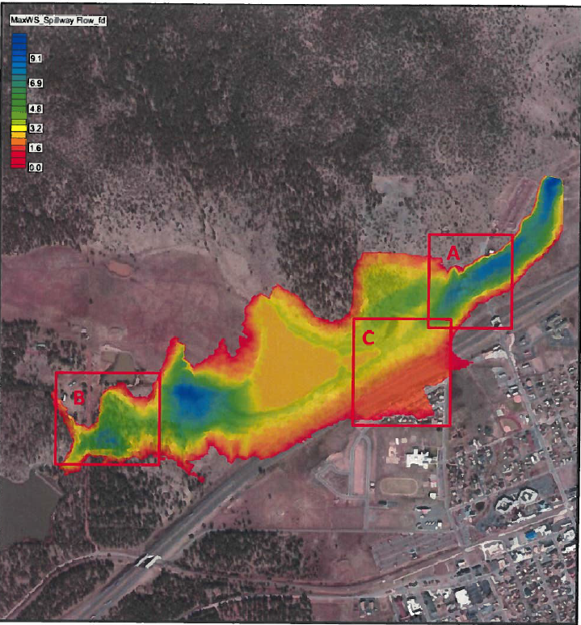
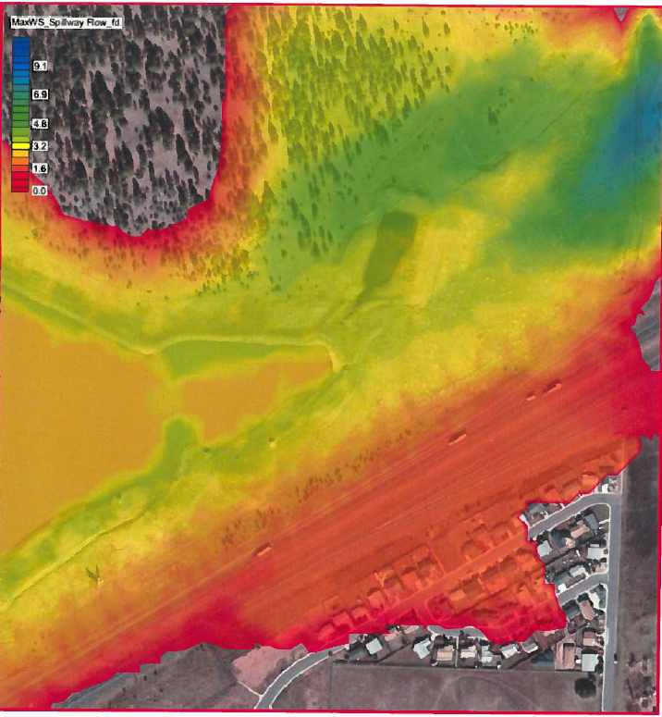
ADWR Static Dam Break Analysis
Images from ADWR

Slide 21
Budget
Task | Total Hours | Billable Rate | Total Cost
Literature Review | 30 | $40/hr. | $1,200
Website | 8 | $80/hr. | $640
Site Surveying & Inventory | 21 | $80/hr. | $1,680
Hydro Analysis | 28 | $80/hr. | $2,240
Overtopping Analysis | 31.5 | $80/hr. | $2,520
Erosion Analysis | 8 | $80/hr. | $640
Slope Stability Analysis | 31.5 | $80/hr. | $2,520
Spillway Failure Analysis | 10 | $80/hr. | $800
Final Report* | 48 | $80/hr. | $3,840
Total Project Cost |  | $16,080
*Final Report also includes the Final Presentation

Slide 22
Conclusion
Dam and spillway weir efficiently constructed to be safe in every failure mode
Very minor impact on Williams even in worst-case scenario conditions
Recommendations
  Complete Emergency Action Plan
  Improve outlet works
  Remove deep-rooted vegetation
  Perform dam break analysis with dynamic water conditions

Slide 23
Acknowledgments
Arizona Department of Water Resources
  Craig Brown
    All Available Documents Pertaining to West Cataract Creek Dam
    In House Dam Break Analysis, Completed 10/2013
Dr. Schlinger
  Project Technical Advisor, Capstone Professor
Mr. Mark Lamer
  Project Client, Capstone Professor
Dr. Wilbert Odem
  Capstone Prep Professor
Dr. Bridget Bero
  Capstone Professor

Slide 24
Questions?

